Slide 1
To be successful in business you need to make great predictions.
In order to make great predictions, you need a lot of data.
Good quality data

Slide 2

We will start with the fun part…
Your presentations!

Slide 3
I will create random break rooms of 3 students.
Organize yourselves to present in order.
Each student take 5 minutes to present your data, observations and conclusions.
Then 2 minutes for question and recommendations from the other 2 students.
Then we second student and third student will present in order.
This activity should not take more than 25 minutes.
Take notice of all the observations and recommendations given by your classmates
This will help you improve your data analytics and presentation skills

Slide 4

Short R test
Relax, it’s fun and not complicated
It’s more like a learning practice
5 points grade

Slide 5
Get ready!
On your computer, open the folder you created for this class.
Go to CANVAS, Discussion M4 Class Test, and download the R file (InClassRtest_01.R) and the CSV data file (car_sale_RTest1.CSV).
Place these 2 files into your class folder.
That folder should contain an R project file already in it; you created this file by following the indications I send on a video during the weekend.
Open your R project file, this will open R Studio.
Go to the Files section in your R Studio and double click the R file InClassRtest_01.R to open it.
Click on the CSV file and import it into the RStudio environment.
Start working on the R file (15 minutes).

Slide 6
Random Variables

Slide 7
Random Variables and Their Probability Distributions
Sometimes, the value of a variable X cannot be stated with certainty.
In such cases, the variable may take one of several possible values.
There are probabilities associated with each value the random variable takes.
This is called a random variable.
“A random variable is a variable whose value is determined as a consequence of a random experiment”

Slide 8
Discrete vs continuous random variables
One easy way to differentiate them:
Discrete cannot be broken down into fractions or decimals and can be counted. They can assume only separate or distinct values.
They use binomial and Poison distributions.
e.g., cars, homes.
Continuous can be broken down into fractions and decimals and are measured. They can assume any value on an interval or intervals.
They use normal distributions.
E.g. weight.

Slide 9
Discrete vs continuous random variables
One easy way to differentiate them:
Discrete cannot be broken down into fractions or decimals and can be counted. They can assume only separate or distinct values.
They use binomial and Poison distributions.
e.g., cars, homes.
Continuous can be broken down into fractions and decimals and are measured. They can assume any value on an interval or intervals.
They use normal distributions.
E.g. weight.
Can you provide example of each variable?

Slide 10
The following are examples of discrete random variables:
1. The score of a baseball team in a game.
2. The number of tails observed when a coin is tossed twice.
3. The average of grades in a test.
The following are examples of continuous random variables:
1. The amount of soda in a randomly chosen 12-ounce can of a particular brand.
2. The amount of time it takes a randomly chosen runner to run a mile.
3. The area of a randomly drawn circle.

Slide 11
Subsets of data: time of the day, buy or not, how much they spend, age, etc.
The smartest thing to do, no matter what project you work on, is to start observing and collecting data from the beginning.
What data you will collect from now on?
What information this data will give you to help you improve your project?

Slide 12
Discrete Probability Distribution

Slide 13
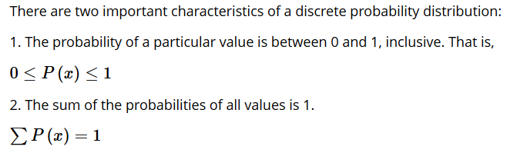
Discrete probability distribution
Describes the probability of occurrence of each value of a discrete random variable.
For a binomial distribution, each event has two possible outcomes
All events are identical and independent

Slide 14
Let’s remember the coin example

Slide 15

Tail
If we toss the coin twice.
What is the probability of obtaining no tails?
P (X=0)
What is the probability of obtaining one tail?
P (X=1)
What is the probability of obtaining two tails?
P (X=2)
Head

Slide 16
Tail
Head
S = {TT, TH, HT, HH}
TH = HT
X= TT, (TH, HT), HH
P(X=0)=P(HH)=1/4=0.25
P(X=1)=P({HT,TH})=P(HT)+P(TH)=1/4+1/4=0.5
P(X=2)=P(TT)=1/4=0.25

Slide 17
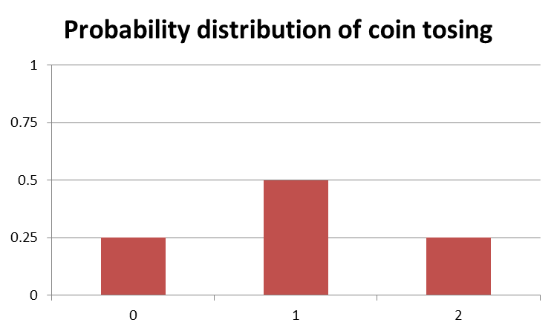

Sample space:
S = {TT, TH, HT, HH}
Probability
Cumulative Probability
Number of tails observed

Slide 18
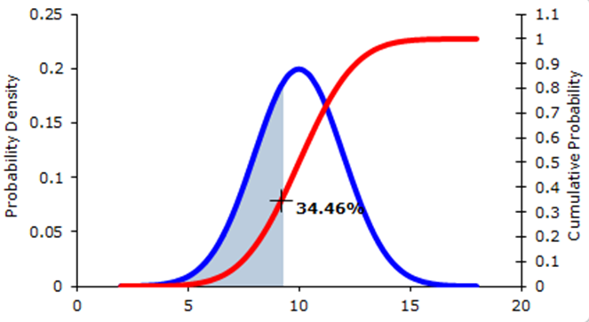

Slide 19
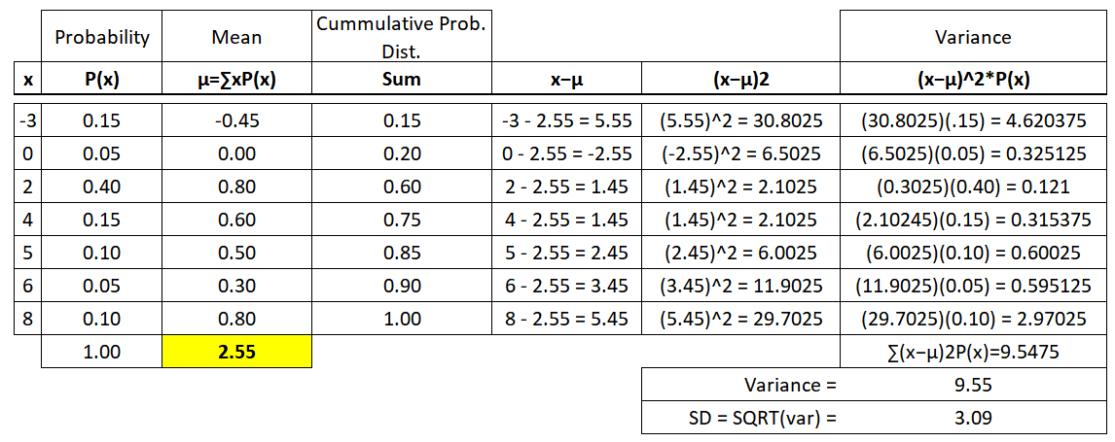
Discrete Probability Distributions (Binomial & Poisson Distributions)
To obtain the mean and standard deviation of a discrete probability distribution

Slide 20
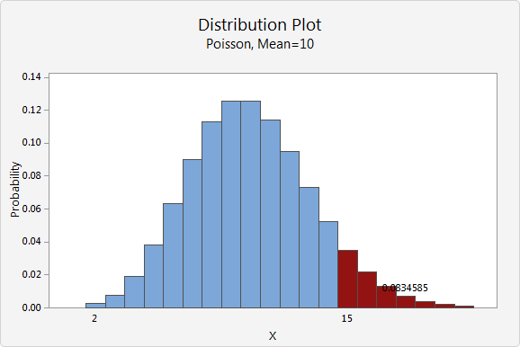
Discrete distribution
Describes the probability of occurrence of each value of a discrete random variable.
Poison distribution: describes the probability that an event will occur a given number of times in a given interval.
Each event is independent of the others
The rate of occurrence is constant (does not vary over time)
Two events cannot occur at the same instant
The probability of an event occurring in an interval is proportional to the length of that interval
Set of countable values presented in tabular form

Slide 21

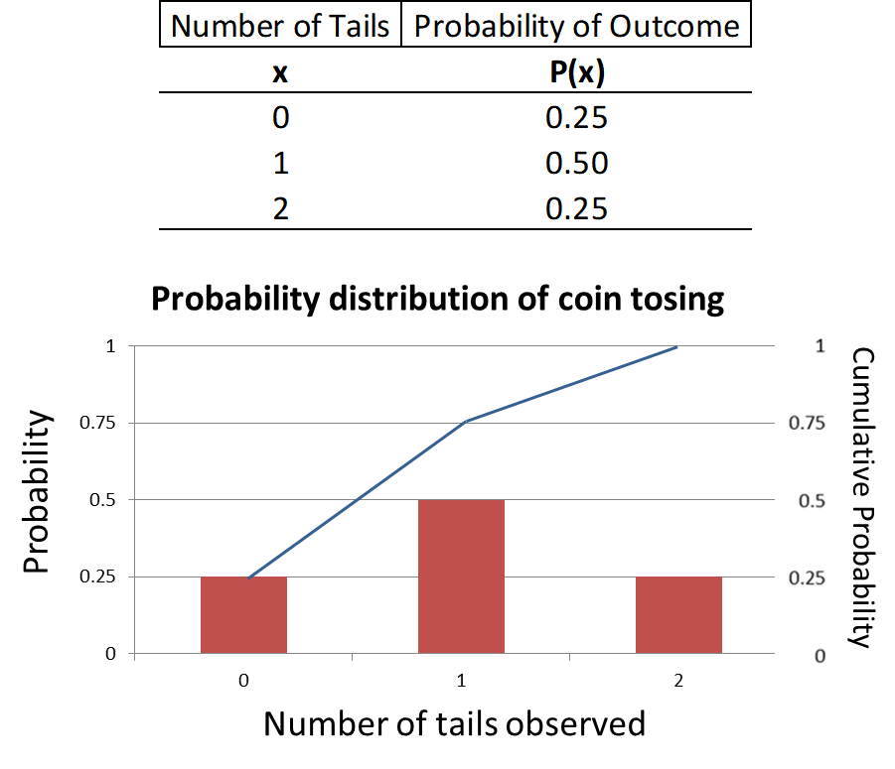
We already observed the probabilities associated with tossing a coin twice.
S₁ = { 1,2,3,4,5,6}
What will be the probability distribution of rolling two dice and counting the values?
S₂ = { 1,2,3,4,5,6}

Slide 23
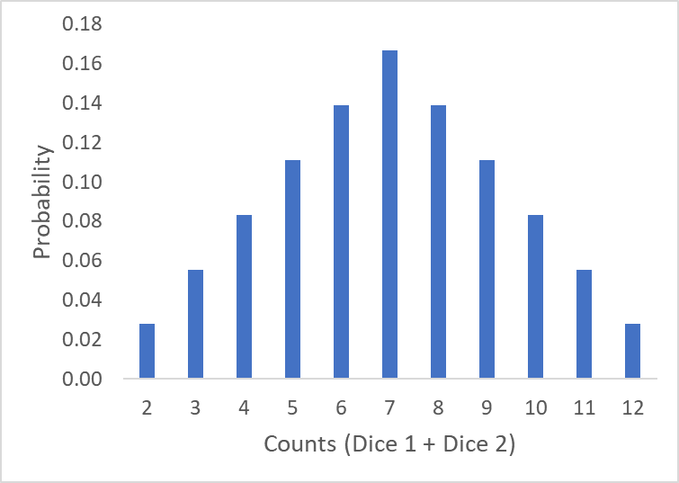
P(5) = 4/36 = 11%
P(8) = 5/36 = 14%

Slide 24
I will leave it up to you to complete the table as we observed above and calculate the mean and standard deviation of this distribution.

Slide 25
Binomial Probability Distributions
There is an important group of discrete random variables that share certain common characteristics.
The random variables that possess those characteristics are called binomial random variables.
The probability distribution of a binomial random variable is called the binomial probability distribution.
The common characteristics of this group of random variables are:
The experiment consists of n identical and independent trials.
There are only two possible outcomes in each trial; one of which is called the Success (S), and the other is called the Failure (F).
The probability of success, denoted by P(S) = p, stays the same from trial to trial.
The probability of failure is denoted by q. Note that p + q = 1, or q = 1 - p.
The binomial r.v. X is the number of successes in n trials.

Slide 26
Binomial Probability Distributions
e.g.,
According to a recent survey, 65% of adult residents are in favor of the new liquor regulations introduced by the city council. A random sample of 200 residents is chosen.
Let X be the number of residents in the sample who are in favor of the new zoning regulations.
Describe why X is a binomial random variable.

Slide 27
Binomial Probability Distributions
n = 200
The answer of one resident does not influence the answer of another resident.
Therefore, the trials are considered independent.
Each trial can have two outcomes, either they are in favor (yes) or not (no).
P(yes) = p = 0.65 AND P(no) = q = 35
These probabilities remain constant in the trials.

Slide 28
Continuous distribution

Slide 29
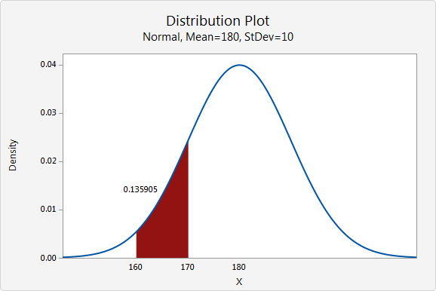
Continuous distribution
Describes the probabilities of the possible values of a continuous random variable.
Set of possible values within a range
Infinite and uncountable
(e.g., Weight)
68–95–99.7 rule
68.27%, 95.45% and 99.73% of the values lie within one, two and three StDev of the mean.
Entire area under the curve is = 1.0

Slide 30
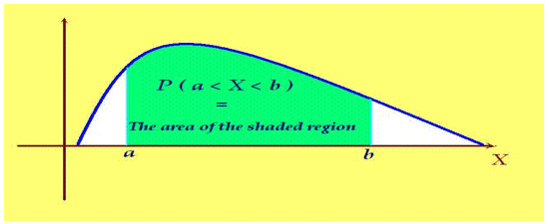

Continuous Probability Distributions
A continuous random variable takes an infinite number of values in a certain range (time, height, width).
The curve describing the probability distribution of a continuous random variable is called the probability density function.
The probability that a continuous random variable X assumes a value between two values a and b is represented by the area under the curve between the points a and b.
Random variable X
P(a<X<b)
since a single point does not constitute any area, the probability that a continuous random variable assumes a particular value is zero. P(X=a) = 0

Slide 31
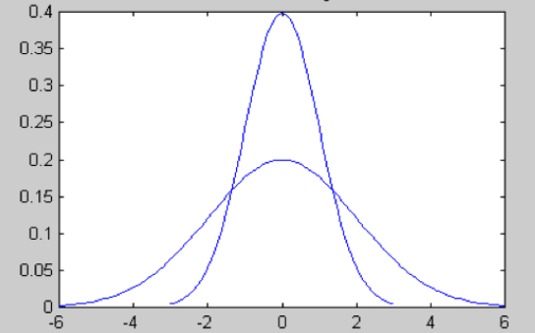

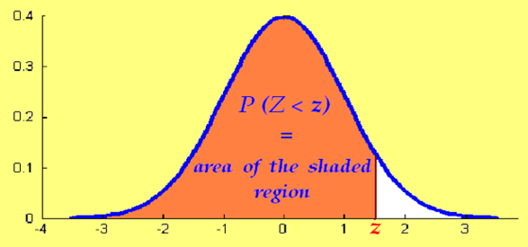
A normal probability distribution is mound-shaped and symmetric and has a single peak at the middle of the distribution, at which the mean and the median and the mode coincide.
How do we find probabilities for all normal distributions?
The standard normal distribution.
A standard normal variable = Z

Slide 32
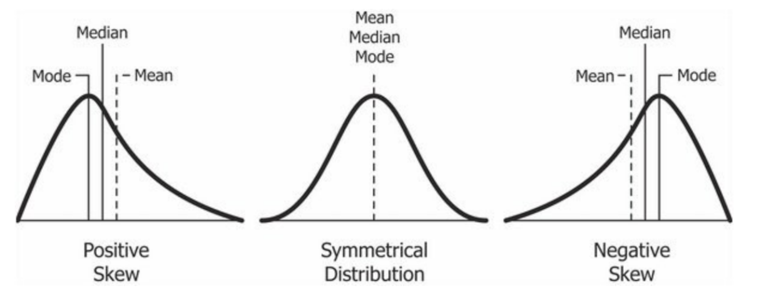
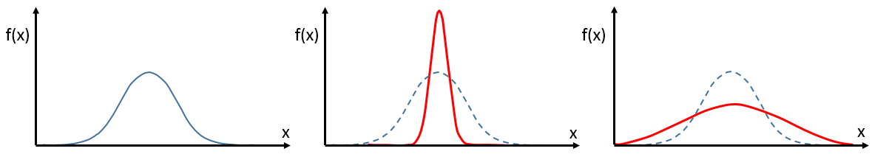
R code:
skewness(dataset$variable)
R code:
kurtosis(dataset$variable)
K = 0 Mesokurtic
Normal, Gaussian Distribution
K > 0 Leptokurtic
Positive kurtosis
K < 0 Platykurtic
Negative kurtosis
http://www.r-tutor.com/elementary-statistics/numerical-measures/kurtosis
http://www.r-tutor.com/elementary-statistics/numerical-measures/skewness

Slide 33
Central Limit Theorem

Slide 34
Central Limit Theorem (CLT)
Given a sufficiently large sample size from a population with a finite level of variance, the mean of all samples will be approximately equal to the mean of the population.
When an infinite number of successive random samples are taken from a population, the sampling distribution of the means will become normally distributed as the sample size becomes larger.

Slide 35
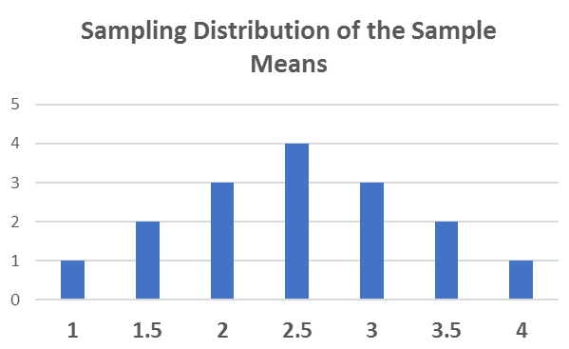

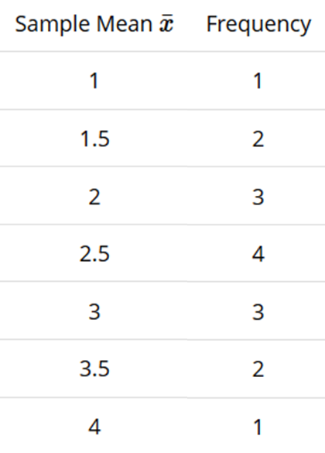

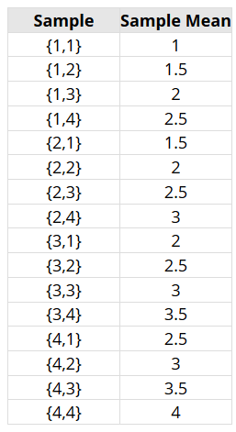
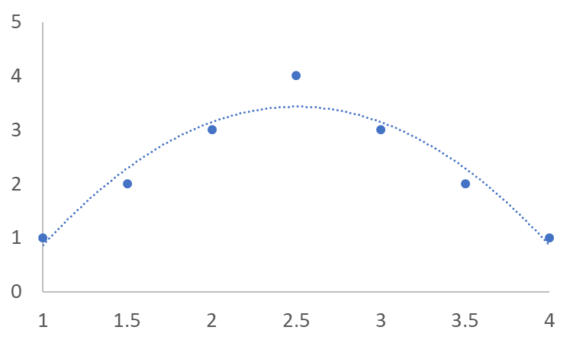
Frequency
Sample mean
Frequency
Sample mean

Slide 36





